Slide 1


myAgro
Food Security Impact Report
How myAgro packages help households reduce their need to cope with hunger

Slide 2
Results Summary | Key Findings
Peanut packages, on average, decreased rCSI by 1.00 in the lean season (6.61 per hectare) and 0.91 year-round (6.45 per hectare)
The ASAA-funded fertilizer (25kg) gifted to Mali farmers in 2023 decreased rCSI by 4.04 in the lean season and 5.35 year-round
Sorghum had a large, significant impact on food security in the lean season only, decreasing rCSI on average by 3.79 (30.32 per hectare)
Millet and watermelon significantly decreased rCSI year-round only, on average by 1.75 (5.23 per hectare) and 1.81 (201.05), respectively
The experience of returning farmers decreased their rCSI scores on average by 0.49 year-round (0.74 per hectare planted of any crop type before 2023)
The rest of the products did not have a statistically significant impact on household food security in either time period, but from the confidence intervals, we can conclude that most of them probably decrease rCSI to some degree
All main result figures on slides 9-10 and interpretations on slides 17-20

Slide 3

Background

Slide 4
Background | ToC Food Security Outcome
ToC Metric: Increase in food security in the lean season
Standard IPC Phases*
Categories To Help Interpret Scores
*Integrated Food Security Phase Classification
How we measure food security: Reduced Coping Strategies Index (rCSI)
Proxy indicator of household food insecurity based on a list of hunger coping strategies
rCSI score range: 0 - 56
Lower score = more food secure household
Hypothesis: myAgro decreases household rCSI
Phase | Category | rCSI Score Range
1 | No to minimal food insecurity | 0-3
2 | “Stressed” phase; some food insecurity | 4-18
3 | Severe or crisis food insecurity | ≥19

Slide 5
Background | Data Collection
Annual Food Security Cycle
October 2023 - September 2024
Post-harvest to lean season (one full food security cycle)
Nearly 12,000 surveys were conducted from a total of 4,731 control and treatment (myAgro) households in 245 villages
Sample villages were selected across geographically clustered zones in each country.
  Mali: Lobougoula, Niena, Koumantou, and Kadiolo
  Senegal: Passi, Ndoffane, Kaolack, Gossas, and Kaffrine
As the data represents one geographic area in each country, the results do not reflect all areas of myAgro operation. Therefore, the conclusions drawn from this analysis are limited to the research areas only. This is important to disclose in results reporting.
For more context and methodology details, see the Current Impact Measurement Initiatives document
Phase | Months | Characteristics
Peak | October - January | Harvests are plentiful
Gradual decline | February - May | Food stocks and monetary resources dwindle
Lean season | June - September | Supplies from the previous harvest are lowest; the most difficult period

Slide 6

Background | Analysis Method
Causation, NOT Correlation
Using advanced data science and statistical techniques, our results reflect the causal effect of myAgro intervention on household food security (with all other variables held constant).
  This is much more powerful in reporting than the simple correlation (used in the past).
Annual impact reporting tells us that each product has different levels of economic impact on clients. We therefore expect the same to be true for household food security impact.
Critically, our analytical approach allows us for the first time to get:
  The impact of each individual product on food security
  The impact of being a returning client on food security (the impact of farming with myAgro for more than one season)

Slide 7
Results

Slide 8
Results | Context for Interpretation
Understand sample rCSI outcomes to help interpret the results
The results in the following slides reflect the change (decrease) in rCSI that myAgro products cause
Before looking at results, we look at the sample’s rCSI outcomes (below) so we can interpret the significance of a results’ magnitude, and therefore the meaning of the change for a household’s food security*
Ex. A median control household (rCSI = 6) would move from Phase 2 food security to Phase 1 (rCSI ≤ 4 ) with a myAgro package that decreases rCSI by 3
 | All |  | Treatment |  | Control
 | Year-round | Lean Season | Year-round | Lean Season | Year-round | Lean Season
Mean | 7.06 | 8.29 | 4.74 | 6.47 | 9.39 | 10.11
Median (50%) | 4 | 5 | 1 | 3 | 6 | 6
Minimum | 0 | 0 | 0 | 0 | 0 | 0
Maximum | 56 | 56 | 51 | 50 | 56 | 56
25th Percentile | 0 | 0 | 0 | 0 | 0 | 0
75th Percentile | 11 | 13 | 7 | 11 | 15 | 16
Notes:
* These numbers are for reference only; they are not indicative of impact. For example, taking the difference in mean treatment and control rCSI scores is NOT valuable.

Slide 9
Results | Full Year Conclusions
Statistically Significant Impact (P≤.05)
Of myAgro products on year-round household rCSI
RESULT | On average, myAgro sample clients planted… (hectares) | And decreased household food insecurity (rCSI) by…
Millet | 0.335 | 1.75
Peanut | 0.141 | 0.91
Watermelon | 0.009 | 1.81
myAgro Packages Planted in Past Seasons* | 0.656 | 0.49
25kg Fertilizer Gift** | 0.250 (assumption) | 5.35
REFERENCE (Product Potential)
With every hectare planted of… | Millet | Peanut | Watermelon | Any Product Before 2023
Household food insecurity (rCSI) decreases by… | 5.23 | 6.45 | 201.05 | 0.74
Notes:
*Total hectares of any crop type planted in any season before 2023. To be clear, this is additional impact for households on top of the impact of their 2023 packages.
**ASAA-funded 25kg of DAP gifted to all delivered Mali farmers in 2023

Slide 10
Results | Lean Season Conclusions
Statistically Significant Impact (P≤.05)
Of myAgro products on lean season household rCSI
RESULT | On average, myAgro sample clients planted… (hectares) | And decreased household food insecurity (rCSI) by…
Peanut | 0.151 | 1.00
Sorghum | 0.125 | 3.79
25kg Fertilizer Gift** | 0.250 (assumption) | 4.04
REFERENCE (Product Potential)
With every hectare planted of… | Peanut | Sorghum
Household food insecurity (rCSI) decreases by… | 6.61 | 30.32
Notes:
**ASAA-funded 25kg of DAP gifted to all delivered Mali farmers in 2023

Slide 11
Results | Full Year Not Conclusive
Year-round impact for the remaining products is inconclusive, but we can say that some probably decrease rCSI
For the following products, the range of possible values in which the true result likely lies (the confidence interval) is mostly negative. This means that they probably decrease rCSI year-round.
REFERENCE (Product Potential per Hectare)
With every hectare planted of… | Cowpea | Okra (significant P≤.10) | Rice | Bissap
Household food insecurity (rCSI) might change by… | -23.54 | -48.77 | -31.47 | -21.93
Where the true result is likely between (confidence interval)... | [-54.65, 7.57] | [-104.64, 7.09] | [-90.59, 27.66] | [-51.38, 7.51]
Products with no impact on food security year-round (neutral, not significant year-round effects) are maize 1.30 [-6.04, 8.65] and sorghum -0.88 [-14.18, 12.43]

Slide 12
Results | Lean Season Not Conclusive
Lean season impact for the remaining products is inconclusive, but we can say that some probably decrease rCSI
For the following products, the range of possible values in which the true result likely lies (the confidence interval) is mostly negative. This means that they probably decrease rCSI in the lean season.
REFERENCE (Product Potential per Hectare)
With every hectare planted of… | Millet | Rice | Bissap | Watermelon
Household food insecurity (rCSI) might change by… | -3.76 | -58.27 | -39.25 | -122.21
Where the true result is likely between (confidence interval)... | [--9.58, 2.05] | [-160.93, 44.39] | [-94.41, 15.91] | [-381.50, 137.09]
Products with no impact on food security in the lean season (neutral, not significant year-round effects) are cowpea -1.20 [-46.20, 43.81], maize -0.94 [-25.33, 23.45], okra 8.74 [-80.08, 97.55], and previous season products -0.38 [-2.08, 1.32].

Slide 13
Results | rCSI Comparison Over Time
We use weighted averages to visualize treatment and control group rCSI scores across the year
This weighting technique, called IPTW*, allows us to look at the separate outcomes of the treatment and control groups while accounting for variables that influence food security (other than myAgro)–like poverty level (PPI), farm size, and main crops cultivated.
By giving more weight to certain observations, IPTW balances these characteristics across groups, getting our estimates closer to what we'd see in a randomized control trial.
However, it is important to note that the myAgro outcomes are aggregated across treatments (package product and size are not accounted for).
These results don’t tell a story alone; they supplement the main conclusions.
Notes:
* Inverse of treatment probability (inverse of propensity score)

Slide 14
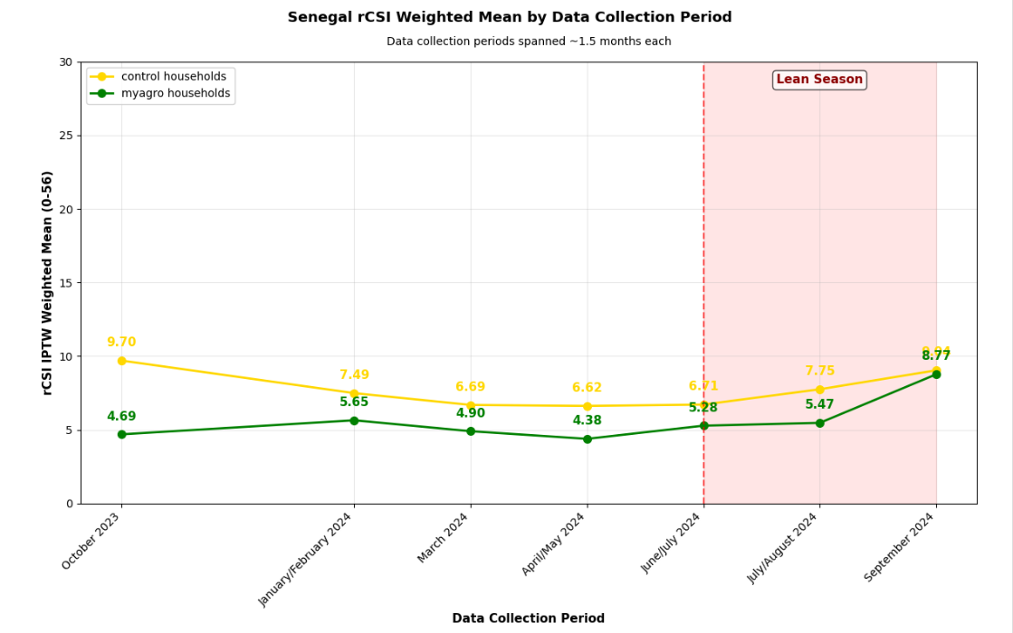
Results | Senegal rCSI Over Time

Slide 15
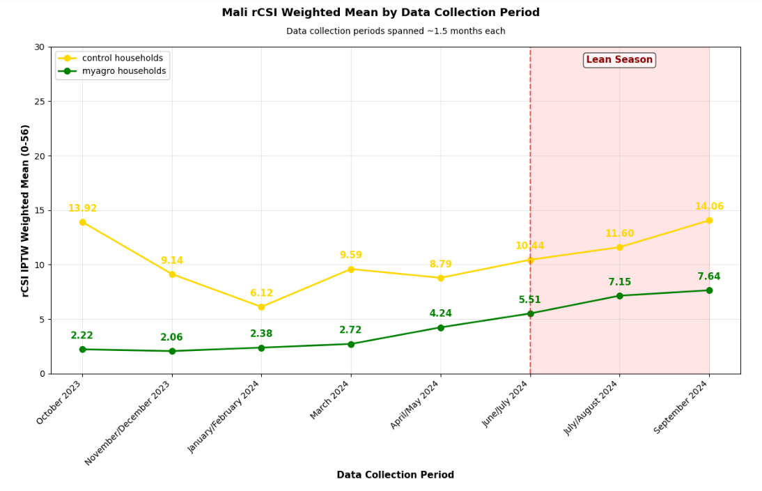
Results | Mali rCSI Over Time

Slide 16
Interpretation

Slide 17
Interpretation | High-impact Packages
Peanut packages and the fertilizer gift were the most robust myAgro interventions
They made significant impact year-round and in the lean season on food security
Average peanut impact is higher in the lean season by 0.09 (0.91 vs 1.00)
  On average, a myAgro peanut package would decrease rCSI from 6 to 5 for a (median) control household in the lean season
Average fertilizer gift impact is lower in the lean season, but still relatively large (5.35 vs 4.04)
  On average, the fertilizer gift decreased rCSI from 6 to 1.96 for a (median) control household in the lean season
Fertilizer impact is notably large compared to the other packages
  This is unsurprising, as it likely boosted overall productivity with no additional cost to Mali households

Slide 18
Interpretation | Lean Season Sorghum
Sorghum packages improve household food security primarily when they need it most–during the lean season
Sorghum plays a specific role as a “hunger crop”, with no impact year-round (confidence interval centered close to 0), yet emerging with high impact in the lean season (decreasing rCSI by 3.79 on average; 30.32 per hectare).
  On average, a myAgro sorghum package would decrease rCSI from 6 to 2.21 for a (median) control household in the lean season.
The difference in results is conceptually consistent with seasonal vulnerability. Outside the lean season (e.g., post-harvest), baseline food security is already higher, so the additional impact of the sorghum package is smaller and harder to detect. Over the entire year, the average effect is diluted by periods when food security is naturally higher.
Even though sorghum is likely considered secondary for human consumption in Mali as it is in Senegal, its properties (good storage, drought tolerance) may make it especially valuable when households are most vulnerable. Farmers might specifically reserve sorghum for lean season consumption–whether due to storage longevity, preference, or both.

Slide 19
Interpretation | Full Year Impact Only
Millet, watermelon, and past myAgro experience had significant impact year-round, but not in the lean season
Millet and watermelon impact lost significance in the lean season, which could suggest they are consumed/sold earlier in the year
  Watermelon must be consumed fresh
  Millet may be preferred for consumption over other crops
On average, a myAgro watermelon package would decrease rCSI from 6 to 4.19 for a (median) control household in the lean season
On average, a myAgro millet package would decrease rCSI from 6 to 4.25 for a (median) control household in the lean season
Farmers with myAgro experience may overall have more resources and better food security strategies, but these don't specifically buffer against lean season stress
myAgro experience has lasting impact on food security–returning households have rCSI lower than new households by 0.49 on average. This impact is in addition to the 2023 package impact.

Slide 20
Interpretation | Results vs 2023 Impact
The food security impact results are consistent with 2023 impact per farmer
The five myAgro products with statistically significant food security impact (year-round and/or lean season) also had the five highest impact per farmer results in 2023
 | 2023 Impact per Farmer w/ Rank
Crops with Significant Impact on Food Security | Senegal | Mali
Peanut | $498 (1) | $71 (3)
25kg Fertilizer Gift | - | $117* (1)
Millet | $109 (2) | -
Sorghum | - | $102 (2)
Watermelon | $59 (3) | -
Notes:
* Average impact per farmer across crop types that the fertilizer gift was used to grow. The average was weighted by crop share of total hectares, according to survey data on how farmers used the fertilizer.

Slide 21
Other Insights

Slide 22
Other Insights | Country Differences
Senegal households are more food secure than Mali households
After controlling for myAgro intervention and other covariates, we found households in Senegal to have, on average, rCSI scores that are:
  2.59 points lower than Mali households year-round (P≤.05)
  3.75 points lower than Mali households in the lean season (P≤.05)
This indicates better food security in Senegal

Slide 23
Other Insights | myAgro Participation
Households that are more likely to plant myAgro packages are already slightly more food secure
Selection bias naturally occurs in the data because the treatment is self-selected (farmers decide whether or not to participate when the option is available in their village), rather than randomly selected (like in a randomized control trial)
When isolating this bias, we found that myAgro tends to attract farmers* who are already slightly more food secure (by about 1-3 rCSI points)
Since we controlled for this bias, the results indicate that the program nonetheless provides additional food security benefits through the packages alone
In other words, our treatment effects are not just an artifact of selection - they represent real value from the intervention itself
Notes:
Based on propensity score (likelihood of treatment), not participation status. Propensity score was calculated for all households using their characteristics: poverty probability (PPI), main crop type(s) cultivated, and the total area of land farmed on. Propensity score was added as a covariate in the model to control for these characteristics.

Slide 24
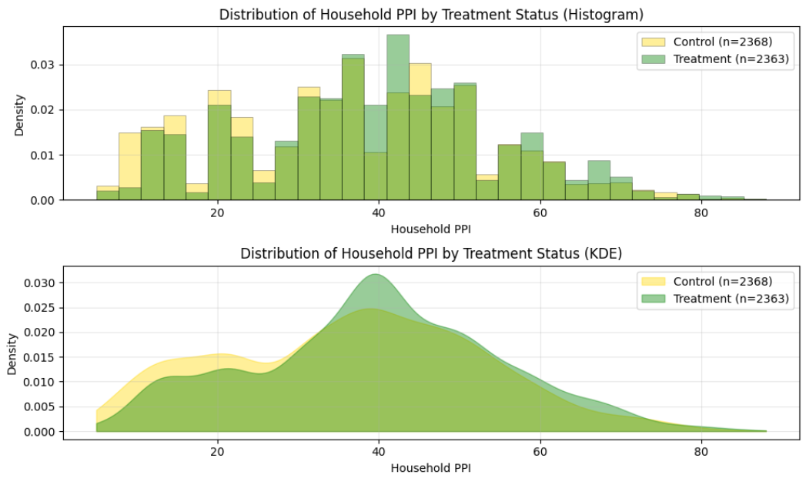
Other Insights | Poverty Probability Index
Household PPI Summary Statistics Higher score = lower poverty likelihood
 | Treatment | Control
Mean | 39.57 | 36.71
Median | 40 | 38
SD | 15.33 | 16.17
Range overlap: [5, 88]
Overlap coefficient: 0.853 (Excellent: The control sample is a valid comparison group)

Slide 25
Appendix A | Key Terms
 | Definition | External Resources
Theory of Change (ToC) | A framework that outlines how and why a particular intervention or program is expected to lead to desired outcomes and impacts. It includes outcome indicators that help demonstrate whether reality matches the expected results. | About the Theory of Change (IDinsight Impact Measurement Guide)
Reduced Coping Strategies Index (rCSI) | Measures the frequency and severity of short-term behavioral strategies a household uses when it cannot access enough food or money to buy food. A higher score indicates more coping, and therefore higher food insecurity. | The Coping Strategies Index Field Methods Manual (2008) IndiKit Indicators: rCSI
Integrated Food Security Phase Classification (IPC) | A classification framework used to determine the severity and extent of acute and chronic food insecurity and acute malnutrition situations within countries, according to internationally recognised standards. | IPC Overview IndiKit Indicators: rCSI to IPC phase coding guidance
Poverty Probability Index (PPI) | A simple yet statistically-sound poverty measurement tool that scores the answers to 10 questions about a household’s characteristics and asset ownership. The PPI score may be used to compute the likelihood that the household is living below the poverty line. | About PPI

